Slide 1
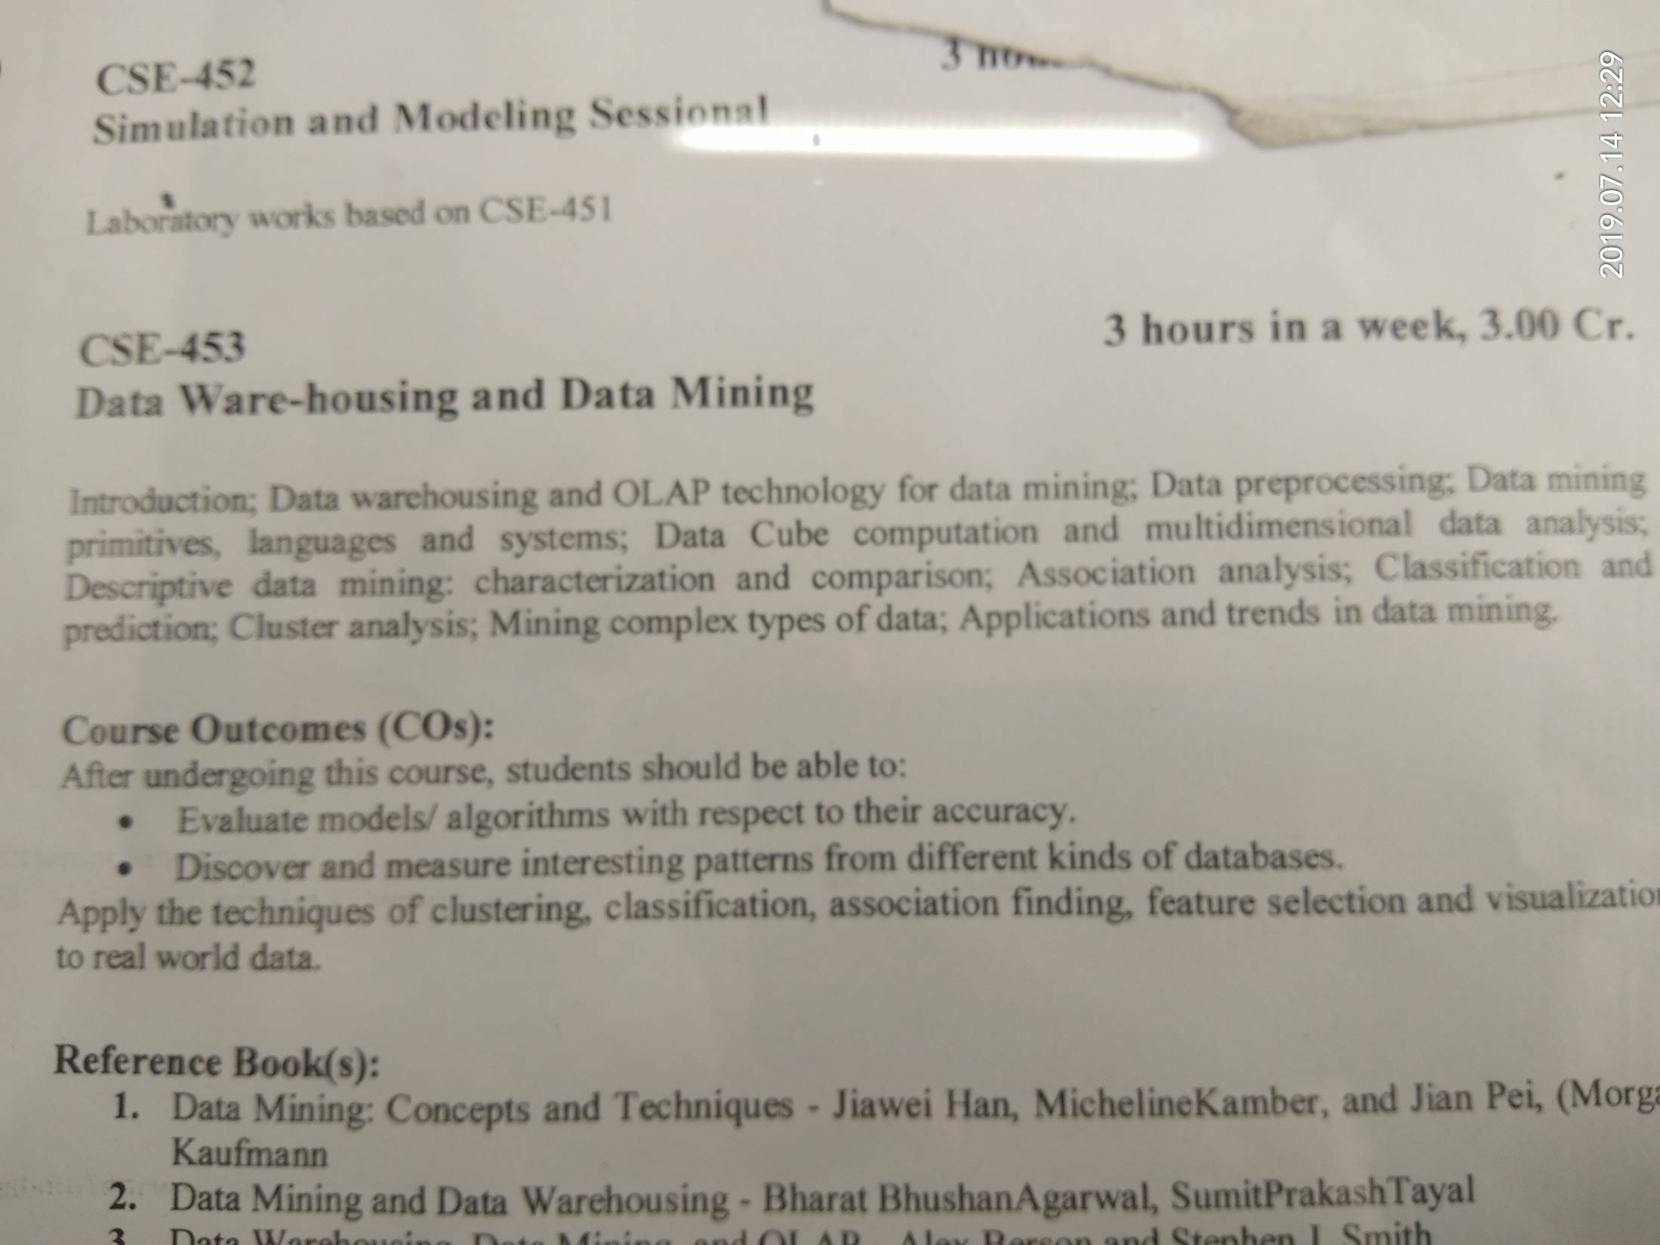
Data Mining: Concepts and Techniques

Slide 2
Data Mining:
Concepts and Techniques
— Chapter 1 —

Slide 3
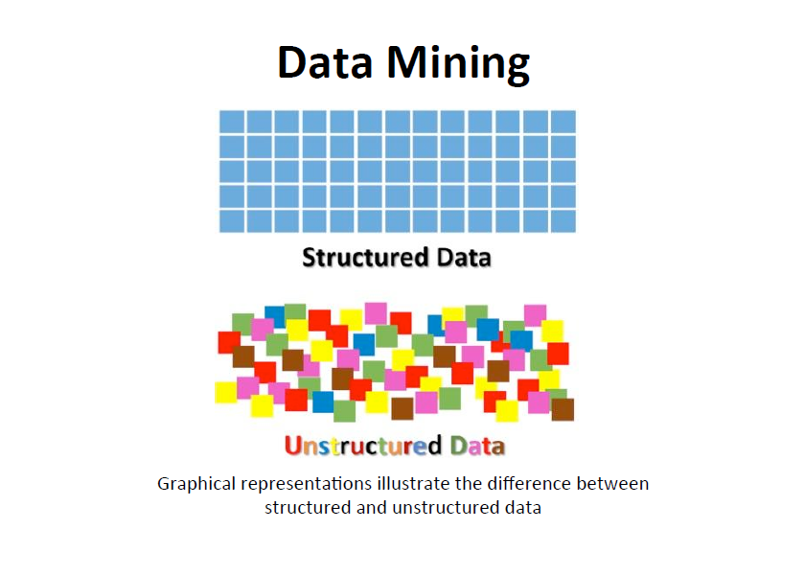
Data Mining: Concepts and Techniques

Slide 4
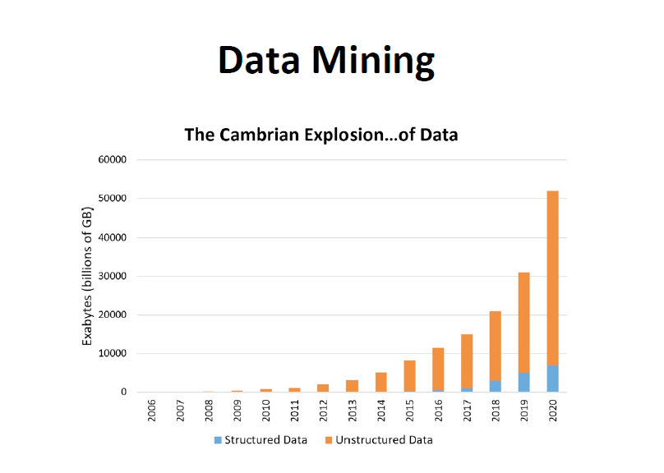
Data Mining: Concepts and Techniques

Slide 5
Chapter 1. Introduction
Why Data Mining?
What Is Data Mining?
A Multi-Dimensional View of Data Mining
What Kind of Data Can Be Mined?
What Kinds of Patterns Can Be Mined?
What Technology Are Used?
What Kind of Applications Are Targeted?

Slide 6
Why Data Mining?
The Explosive Growth of Data: from terabytes to petabytes
  Data collection and data availability
    Automated data collection tools, database systems, Web, computerized society
  Major sources of abundant data
    Business: Web, e-commerce, transactions, stocks, …
    Science: Remote sensing, bioinformatics, scientific simulation, …
    Society and everyone: news, digital cameras, YouTube
We are drowning in data, but starving for knowledge!
“Necessity is the mother of invention”—Data mining—Automated analysis of massive data sets

Slide 7
Evolution of Sciences
Before 1600, empirical science
1600-1950s, theoretical science
  Each discipline has grown a theoretical component. Theoretical models often motivate experiments and generalize our understanding.
1950s-1990s, computational science
  Over the last 50 years, most disciplines have grown a third, computational branch (e.g. empirical, theoretical, and computational ecology, or physics, or linguistics.)
  Computational Science traditionally meant simulation. It grew out of our inability to find closed-form solutions for complex mathematical models.
1990-now, data science
  The flood of data from new scientific instruments and simulations
  The ability to economically store and manage petabytes of data online
  The Internet and computing Grid that makes all these archives universally accessible
  Scientific info. management, acquisition, organization, query, and visualization tasks scale almost linearly with data volumes. Data mining is a major new challenge!
Jim Gray and Alex Szalay, The World Wide Telescope: An Archetype for Online Science, Comm. ACM, 45(11): 50-54, Nov. 2002

Slide 8
Evolution of Database Technology
1960s:
  Data collection, database creation, IMS and network DBMS
1970s:
  Relational data model, relational DBMS implementation
1980s:
  RDBMS, advanced data models (extended-relational, OO, deductive, etc.)
  Application-oriented DBMS (spatial, scientific, engineering, etc.)
1990s:
  Data mining, data warehousing, multimedia databases, and Web databases
2000s
  Stream data management and mining
  Data mining and its applications
  Web technology (XML, data integration) and global information systems
Notes:
Two slides should be added after this one
1. Evolution of machine learning
2. Evolution of statistics methods

Slide 9
Chapter 1. Introduction
Why Data Mining?
What Is Data Mining?
A Multi-Dimensional View of Data Mining
What Kind of Data Can Be Mined?
What Kinds of Patterns Can Be Mined?
What Technology Are Used?
What Kind of Applications Are Targeted?

Slide 10


What Is Data Mining?
Data mining (knowledge discovery from data)
  Extraction of interesting (non-trivial, implicit, previously unknown and potentially useful) patterns or knowledge from huge amount of data
Alternative names
  Knowledge discovery (mining) in databases (KDD), knowledge extraction, data/pattern analysis, data archeology, data dredging, information harvesting, business intelligence, etc.
Watch out: Is everything “data mining”?
  Simple search and query processing

Slide 11
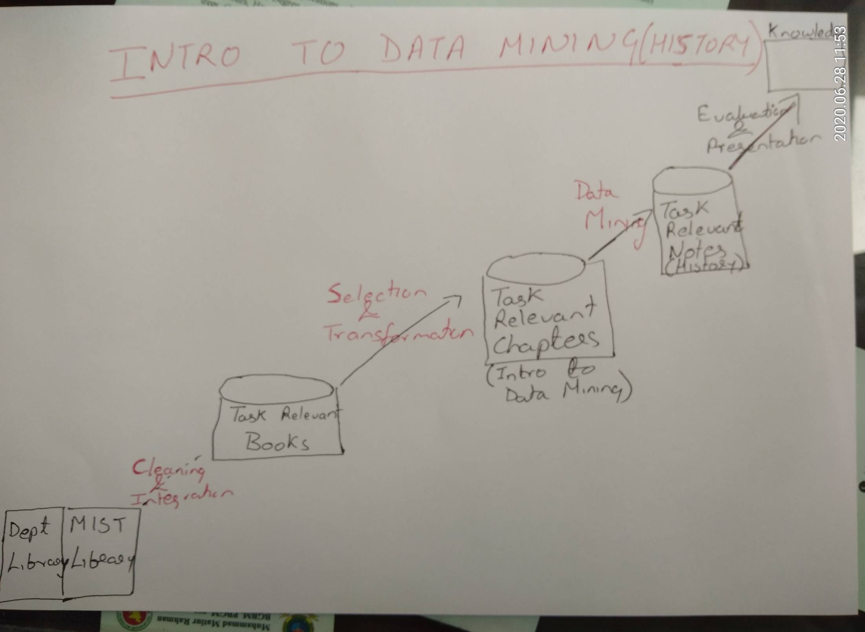

Data Mining: Concepts and Techniques

Slide 12
Knowledge Discovery (KDD) Process
Knowledge
This is a view from typical database systems and data warehousing communities
Data mining plays an essential role in the knowledge discovery process
Pattern Evaluation
Identify interesting patterns
Data Mining
Task-relevant Data
Data Transformation
Selection
To retrieve data relevant to analysis
Data Warehouse
Data Cleaning
Remove noise & inconsistent data
Data Integration
Combine multiple data Sources
Databases

Slide 13
Example: A Web Mining Framework
Web mining usually involves
  Data cleaning
  Data integration from multiple sources
  Warehousing the data
  Data cube construction
  Data selection for data mining
  Data mining
  Presentation of the mining results
  Patterns and knowledge to be used or stored into knowledge-base

Slide 14
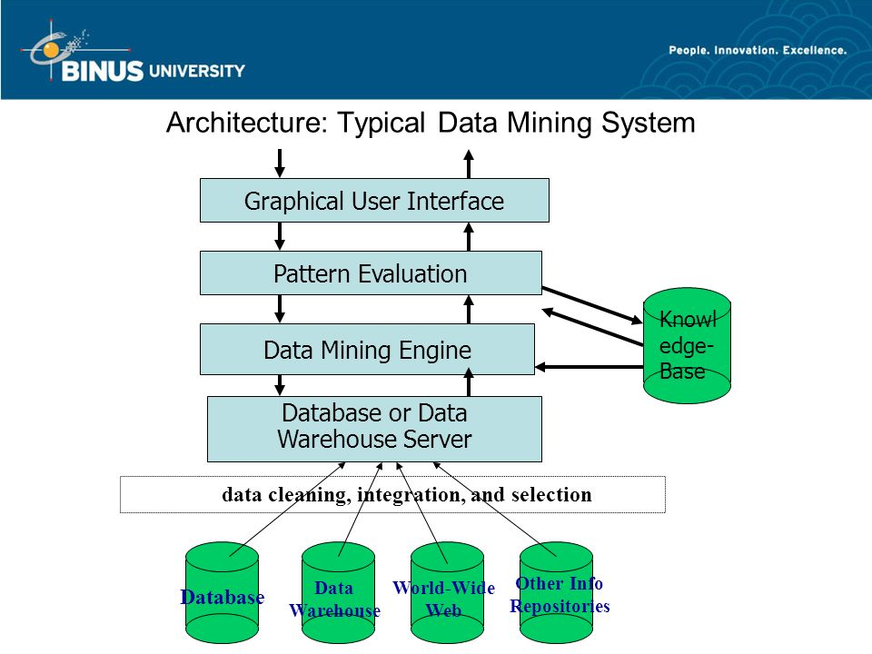
Focuses search towards interesting patterns
Modules for Association & Correlation analysis,
Classification, Prediction, Cluster Analysis
Domain Knowledge-
To guide search
Data Mining: Concepts and Techniques

Slide 15
Data Mining in Business Intelligence
Increasing potential
to support
business decisions
End User
Decision Making
Data Presentation
Business
Analyst
Visualization Techniques
Data Mining
Data
Analyst
Information Discovery
Data Exploration
Statistical Summary, Querying, and Reporting
Data Preprocessing/Integration, Data Warehouses
Data Sources
DBA
Paper, Files, Web documents, Scientific experiments, Database Systems

Slide 16
Example: Mining vs. Data Exploration
Business intelligence view
  Warehouse, data cube, reporting but not much mining
Business objects vs. data mining tools
Supply chain example: tools
Data presentation
Exploration

Slide 17
KDD Process: A Typical View from ML and Statistics
Pattern
Information
Knowledge
Input Data
Data Pre-Processing
Data Mining
Post-Processing
Data integration
Normalization
Feature selection
Dimension reduction
Pattern discovery
Association & correlation
Classification
Clustering
Outlier analysis
… … … …
Pattern evaluation
Pattern selection
Pattern interpretation
Pattern visualization
This is a view from typical machine learning and statistics communities

Slide 18
Example: Medical Data Mining
Health care & medical data mining – often adopted such a view in statistics and machine learning
Preprocessing of the data (including feature extraction and dimension reduction)
Classification or/and clustering processes
Post-processing for presentation

Slide 19
Chapter 1. Introduction
Why Data Mining?
What Is Data Mining?
A Multi-Dimensional View of Data Mining
What Kind of Data Can Be Mined?
What Kinds of Patterns Can Be Mined?
What Technology Are Used?
What Kind of Applications Are Targeted?

Slide 20
Multi-Dimensional View of Data Mining
Data to be mined
  Database data (extended-relational, object-oriented, heterogeneous, legacy), data warehouse, transactional data, stream, spatiotemporal, time-series, sequence, text and web, multi-media, graphs & social and information networks
Knowledge to be mined (or: Data mining functions)
  Characterization, discrimination, association, classification, clustering, trend/deviation, outlier analysis, etc.
  Descriptive vs. predictive data mining
Techniques utilized
  Data-intensive, data warehouse (OLAP), machine learning, statistics, pattern recognition, visualization, high-performance, etc.
Applications adapted
  Retail, telecommunication, banking, fraud analysis, bio-data mining, stock market analysis, text mining, Web mining, etc.

Slide 21
Chapter 1. Introduction
Why Data Mining?
What Is Data Mining?
A Multi-Dimensional View of Data Mining
What Kind of Data Can Be Mined?
What Kinds of Patterns Can Be Mined?
What Technology Are Used?
What Kind of Applications Are Targeted?

Slide 22
Data Mining: On What Kinds of Data?
Database-oriented data sets and applications
  Relational database, data warehouse, transactional database
Advanced data sets and advanced applications
  Data streams and sensor data
  Time-series data, temporal data, sequence data (incl. bio-sequences)
  Structure data, graphs, social networks and multi-linked data
  Object-relational databases
  Heterogeneous databases and legacy databases
  Spatial data and spatiotemporal data
  Multimedia database
  Text databases
  The World-Wide Web
  Ref Section 1.3– Self Study

Slide 23
Chapter 1. Introduction
Why Data Mining?
What Is Data Mining?
A Multi-Dimensional View of Data Mining
What Kind of Data Can Be Mined?
What Kinds of Patterns Can Be Mined?
What Technology Are Used?
What Kind of Applications Are Targeted?

Slide 24
Data Mining Function: (1) Generalization
Information integration and data warehouse construction
  Data cleaning, transformation, integration, and multidimensional data model
Data cube technology
  Scalable methods for computing (i.e., materializing) multidimensional aggregates
  OLAP (online analytical processing)
Multidimensional concept description: Characterization and discrimination
  Generalize, summarize, and contrast data characteristics, e.g., dry vs. wet region
Notes:
I BELIEVE WE MAY NEED TO DO IT IN MORE IN-DEPTH INTRODUCTION, USING SOME EXAMPLES. So it will take one slide for one function, i.e., one chapter we want to cover. Do we need to cover chapter 2: preprocessing and 3. Statistical methods?

Slide 25
Data Mining Function: Association and Correlation Analysis
Frequent patterns (or frequent item sets)
  What items are frequently purchased together in your Chaldal/Lavender?
Association, correlation vs. causality
  A typical association rule
    Diaper → Milk [0.5%, 75%] (support, confidence)
How to mine such patterns and rules efficiently in large datasets?

Slide 26
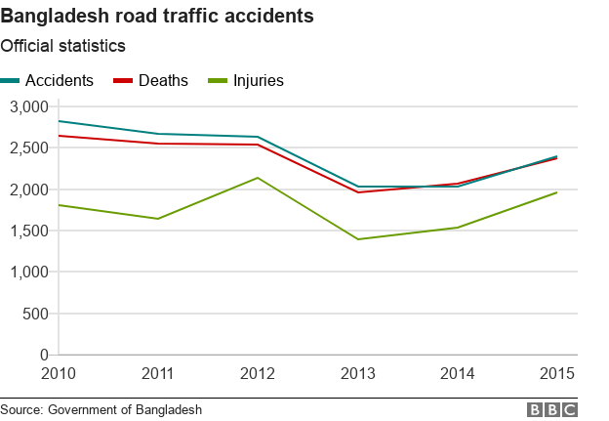
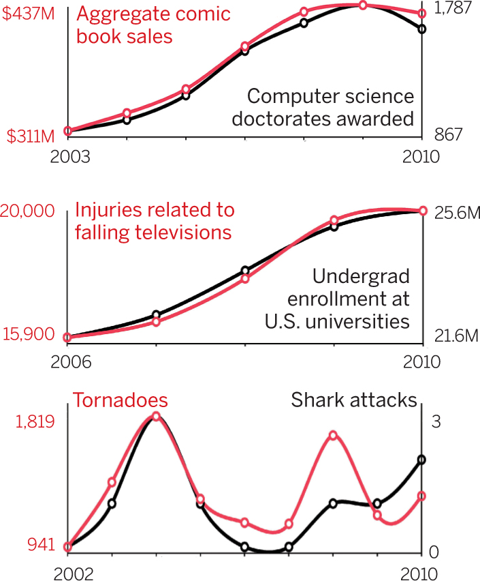
Correlation Vs Causality
Data Mining: Concepts and Techniques

Slide 27

Data Mining Function: Classification
Classification and label prediction (Supervised Learning)
  Construct models (functions) based on some training examples
  Describe and distinguish classes or concepts for future prediction
    E.g., classify countries based on (climate), or classify cars based on (gas mileage)
  Predict some unknown class labels
Typical methods
  Decision trees, naïve Bayesian classification, support vector machines, neural networks, rule-based classification, pattern-based classification, logistic regression, …
Typical applications:
  Credit card fraud detection, direct marketing, classifying stars, diseases, web-pages, …

Slide 28
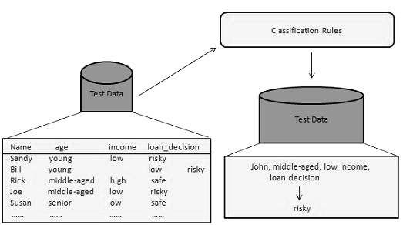
Classification
Data Mining: Concepts and Techniques

Slide 29
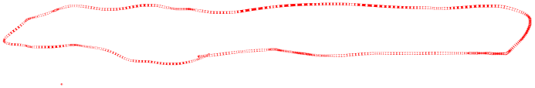
Data Mining Function: Cluster Analysis
Unsupervised learning (i.e., Class label is unknown)
Group data to form new categories (i.e., clusters), e.g., cluster houses to find distribution patterns
Principle: Maximizing intra-class similarity & minimizing interclass similarity
Many methods and applications

Slide 30
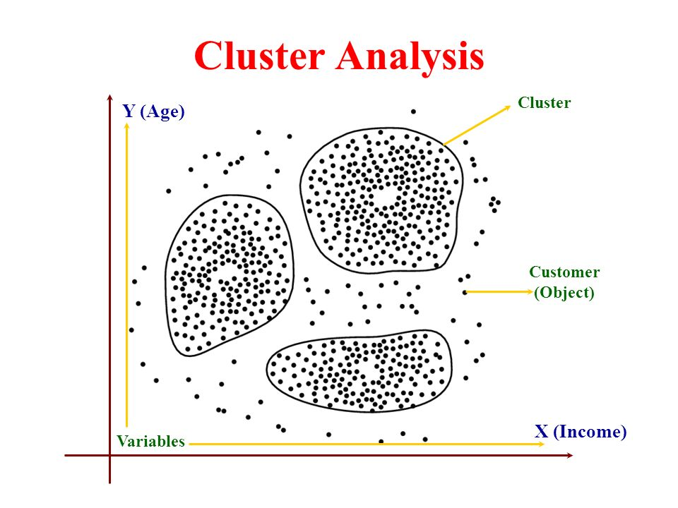
Data Mining Function: Cluster Analysis
Data Mining: Concepts and Techniques

Slide 31
Data Mining Function: Outlier Analysis
Outlier analysis
  Outlier: A data object that does not comply with the general behavior of the data
  Methods: by product of clustering or regression analysis, …
  Useful in fraud detection, rare events analysis

Slide 32
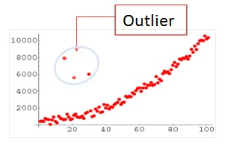
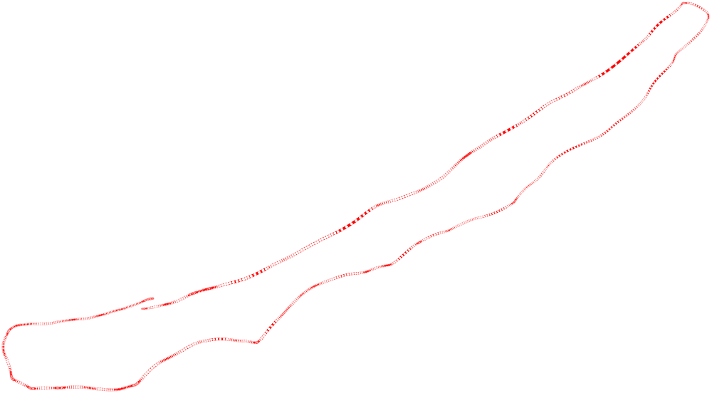
Data Mining Function: Outlier Analysis
Data Mining: Concepts and Techniques

Slide 33
Time and Ordering: Sequential Pattern, Trend and Evolution Analysis
Sequence, trend and evolution analysis
  Trend, time-series, and deviation analysis: e.g., regression and value prediction
  Sequential pattern mining
    e.g., first buy digital camera, then buy large SD memory cards
  Periodicity analysis
  Motifs and biological sequence analysis
    Approximate and consecutive motifs
  Similarity-based analysis
Mining data streams
  Ordered, time-varying, potentially infinite, data streams

Slide 34
Structure and Network Analysis
Graph mining
  Finding frequent subgraphs (e.g., chemical compounds), trees (XML), substructures (web fragments)
Information network analysis
  Social networks: actors (objects, nodes) and relationships (edges)
    e.g., author networks in CS, terrorist networks
  Multiple heterogeneous networks
    A person could be multiple information networks: friends, family, classmates, …
  Links carry a lot of semantic information: Link mining
Web mining
  Web is a big information network: from PageRank to Google
  Analysis of Web information networks
    Web community discovery, opinion mining, usage mining, …
Notes:
This chapter will not be in the new version, will it?
BUT SHOULD WESTILL INTRODCE THEM SO THAT THEY WILL GET AN OVERALL PICTURE?

Slide 35
Evaluation of Knowledge
Are all mined knowledge interesting?
  One can mine tremendous amount of “patterns” and knowledge
  Some may fit only certain dimension space (time, location, …)
  Some may not be representative, may be transient, …
Evaluation of mined knowledge → directly mine only interesting knowledge?
  Descriptive vs. predictive
  Coverage
  Typicality vs. novelty
  Accuracy
  Timeliness
  …

Slide 36
Chapter 1. Introduction
Why Data Mining?
What Is Data Mining?
A Multi-Dimensional View of Data Mining
What Kind of Data Can Be Mined?
What Kinds of Patterns Can Be Mined?
What Technology Are Used?
What Kind of Applications Are Targeted?

Slide 37

Data Mining: Confluence of Multiple Disciplines
Machine
Learning
Pattern
Recognition
Statistics
Applications
Data Mining
Visualization
Algorithm
Database
Technology
High-Performance
Computing

Slide 38
Why Confluence of Multiple Disciplines?
Tremendous amount of data
  Algorithms must be highly scalable to handle such as tera-bytes of data
High-dimensionality of data
  Micro-array may have tens of thousands of dimensions
High complexity of data
  Data streams and sensor data
  Time-series data, temporal data, sequence data
  Structure data, graphs, social networks and multi-linked data
  Heterogeneous databases and legacy databases
  Spatial, spatiotemporal, multimedia, text and Web data
  Software programs, scientific simulations
New and sophisticated applications
Notes:
Add a definition/description of “traditional data analysis”.

Slide 39
Chapter 1. Introduction
Why Data Mining?
What Is Data Mining?
A Multi-Dimensional View of Data Mining
What Kind of Data Can Be Mined?
What Kinds of Patterns Can Be Mined?
What Technology Are Used?
What Kind of Applications Are Targeted?

Slide 40
Applications of Data Mining
Web page analysis: from web page classification, clustering to PageRank & HITS algorithms
Collaborative analysis & recommender systems
Basket data analysis to targeted marketing
Biological and medical data analysis: classification, cluster analysis (microarray data analysis), biological sequence analysis, biological network analysis
Major dedicated data mining systems/tools (e.g., SAS, MS SQL-Server Analysis Manager, Oracle Data Mining Tools).

